Slide 1
Maritime Reporting. Enter Once. Deliver Everywhere.
Mike Powell Adrian Challinor
Seed Round: £50k - £100K
Strategic integration opportunity

Slide 2
The Operational Problem
Masters entering the same data multiple time:
Up to 10 reports, same data, different formats, per day
Owners, Managers, Charterers, Agents, Ports, Insurers
Report requirements can change voyage-by-voyage
High workload on Master & Chief Engineer
Risk of inconsistency and errors
No Standardisation
Fragmented data entry between bridge and engineering
Type of reports:
Noon day
Arrival
Departure
Off-Hire
Bunker

Slide 3
Why this is increasingly critical
Masters have an increasing admin burden
Emissions and CII reporting expanding
Charterers demanding structured data
API Integration is becoming a standard
Commercial disputes often data-driven
E.g. Speed and Performance
The data and reporting burden is increasing, not decreasing.

Slide 4
The core Insight
The problem is not reporting.
The problem is data architecture.
Today:
Reports are template first
We propose:
Data-first architecture
Enter data ONCE. If possible, use automated data acquisition. Generate unlimited structured outputs.

Slide 5
The solution
A centralized maritime reporting platform built on:
IMO Data Compendium field structure
Fleet-configured field selection
Business rule validation (Red / Amber / Green)
Dynamic consumer formatting engine
Multi-format report delivery based on consumers needs
No code to install on vessel
One structured dataset → Multiple stakeholder outputs.

Slide 6
Intelligent Data Quality Layer
Each field:
Has business rules applied
Validates operational plausibility
Validation states:
🔴 Red – must re-enter
🟠 Amber – confirm
🟢 Green – accepted
Benefits:
Reduced disputes
Improved commercial trust
Standardised data integrity
Early anomaly detection
Vessel enters only what is need
Dynamic forms for the vessel
This becomes a quality-control layer — not just a form tool.

Slide 7
Multi-Source Data Integration
We reduce manual input by integrating:
AIS feeds
Weather data
Electronic Deck Logs (eDeckLog)
Bridge & Engine inputs (separate forms)
Temporal reconciliation engine
The system reconciles:
Different entry times
Different onboard departments
External data streams
This improves:
Accuracy
Auditability
Efficiency

Slide 8
Strategic Value to Industry Software Providers
This is not just a reporting tool.
It can act as:
A data ingestion layer
A validation layer
A structured API output engine
A standardised reporting interface
Strategic integration opportunities:
Fleet management platforms
Voyage management systems
Chartering software
Compliance tools
ESG platforms
We become an enabling infrastructure component.

Slide 9
Target Market
Primary adopters:
Ship Owners
Technical Managers
Disponent Owners (Time Charterers)
Global fleet:
~60,000 commercial vessels
Realistic initial target: progressive managers (5–50 vessels)
Commercial model:
Per vessel per month
SaaS recurring revenue
This is scalable across fleet size.

Slide 10
Competition
Metric | Us | Veson | Smart Ship
IMO Compliant | Yes | No | Partially
Custom forms and data | Yes | Yes | No
Dynamic Forms | Yes | No | No
Static, Manual Forms | No | Yes | No
AI Generated Forms | Yes | No | No
AI Data Validation | Yes | No | No
Data exchange to multiple consumers | Yes | No | Yes
Field Level Security | Yes | No | No
Onboard Data Capture | Optional | No | Yes

Slide 11
Business Model
Initial model:
£150–£300 per vessel per month (TBD)
Revenue drivers:
Fleet size
API integrations
Advanced analytics module (future)
Strategic partner opportunity:
White-label integration
Revenue share
Embedded module within existing platform
This is positioned for ecosystem expansion.

Slide 12
Development Roadmap
Phase 1 – MVP
Phase 2 – API & Integration
Phase 3 – Intelligence Layer
Core field database
Form engine
Rules engine
Email / Excel /PDF outputs
1–2 pilot fleets
Structured APIs
Excel output engine
External data feeds
AI-assisted field configuration
Anomaly detection
Fleet benchmarking

Slide 13
Strategic Pathway
Designed for ecosystem integration
Modular architecture
API-ready
White-label capable
Natural acquisition pathway for fleet software providers
Designed for secure data exchange
Work with 3rd Party on-board data collectors

Slide 14



Technical Direction
Highly secure infrastructure
All access validated before any action
Data exchange managed by client
Segregation of company data
AI Assistance
To help build per-vessel forms
Validation of vessel response

Slide 15
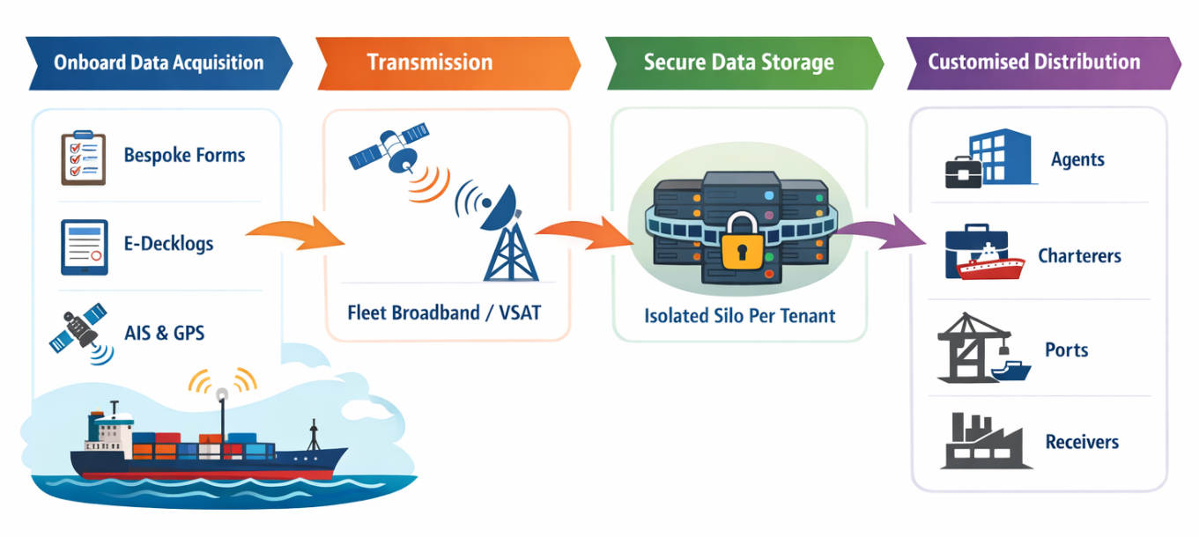
Data Flows

Slide 16
The Ask
We are raising: £50,000 – £100,000 seed capital
This will secure: A share of the marketing company and a seat on the board
From:
Use of funds:
We are seeking:
Strategic maritime software provider
Established maritime services company
Industry-aligned investor
MVP development
Integration framework
Pilot onboarding
Security & compliance hardening
Capital
Industry validation
Integration partnership

Slide 17


Thank You
Adrian Challinor
Osiris Consultants Ltd
adrian.challinor@osiris.co.uk +44-7860-290-883
Mike Powell
Cardinal Point Marine Ltd
mike@cpmarine.co.uk +44-7826-872-606

